Slide 1
Netherlands exit strategy out of TPD
Policy event – Ukraine: transition and residence after March 2027
21 April 2026

Slide 2
Table of contents
Netherlands exit strategy out of TPD
Current situation
National policy within the European framework
Uncertainties and unresolved issues
Facts and figures
PLEASE NOTE ALL POLICIES MENTIONED ARE IN PROPOSAL PHASE

Slide 3
Netherlands exit strategy out of TPD
Current situation – TPD until 04-03-2027
Primary objective – reconstruction of Ukraine
Policy goals
Protection for as long as necessary
Promote and support return
Minimize pressure on (social) services and the asylum chain
Maximum participation: participation and self-reliance
Approach
Return program and support for reconstruction
Provide as much as possible towards regular permits
Transition document

Slide 4
Current situation
Figures
Approx. 135.000 BoTP
Approx. 99.000 in government provided shelters
Legal basis
Temporary law on the Reception of Displaced Persons in Ukraine
Validity of law until end of TPD +1 year
BoTP all apply for asylum – processing of application paused until end of TPD
Execution
Municipalities responsible for providing shelter and (social support)
Regional cooperation coordinated on province-level

Slide 5
Core problem
If no policy measures are taken:
Activation of asylum applications after end of TPD transfers responsibility for shelter to Central Agency for the Reception of Asylum Seekers which would have to triple it’s capacity.
Immigration and Naturalisation Agency has to process all asylum applications. Approximate time frame: 10 years
Posibilities for asylum seekers for work and education limited compared to BoTP

Slide 6
National policy within the European framework
European framework
(council recommendation)
transition to legal statuses (existing or omnibus)
return and sustainable reintegration in Ukraine
provision of information to displaced persons
coordination, monitoring and exchange of information between Member States (LS) and Ukraine
National policy:
regular permit 3 years + transition to regular systems
return policy and reconstruction support
communication strategy to and displaced persons
coordination with LS (solidarity platform and council bodies) and cooperation with Ukraine

Slide 7
Uncertainties and unresolved issues
Geopolitical situation – course of the war
Extension of TPD
Policies of other EU countries - secondary migration flows
Dual intent – ​​return and/or stay
Distribution of displaced persons across the country
Interconnectedness with other (political) challenges: housing market and social services
Cooperation between municipalities & national government

Slide 8
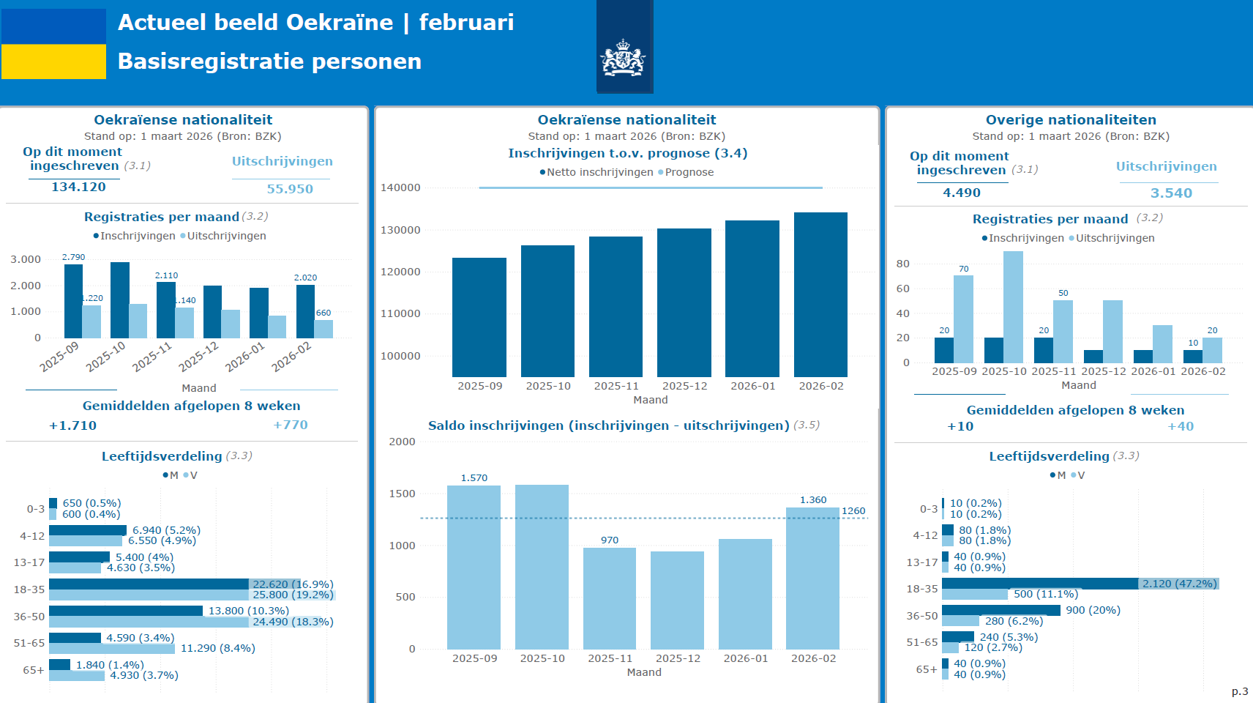

Slide 9
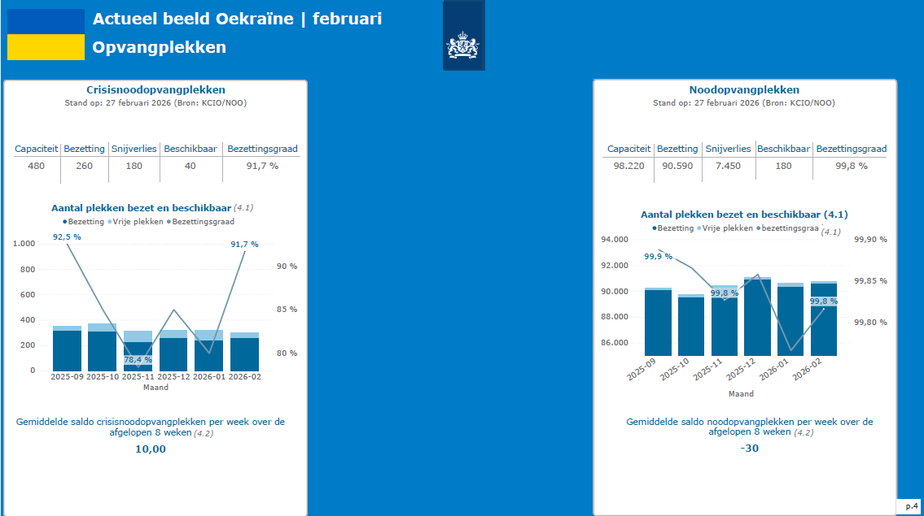

Slide 10
